Slide 1





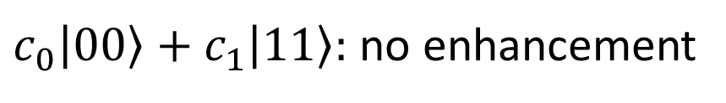
$$|e⟩$$
$$ω_{0}$$
$c_{0}\left|00\right\rangle +c_{1}\left|11\right\rangle :$ no enhancement
$$|m⟩$$
$$ω_{0}$$
$$|g⟩$$

Slide 2
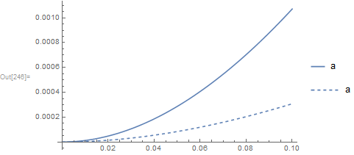





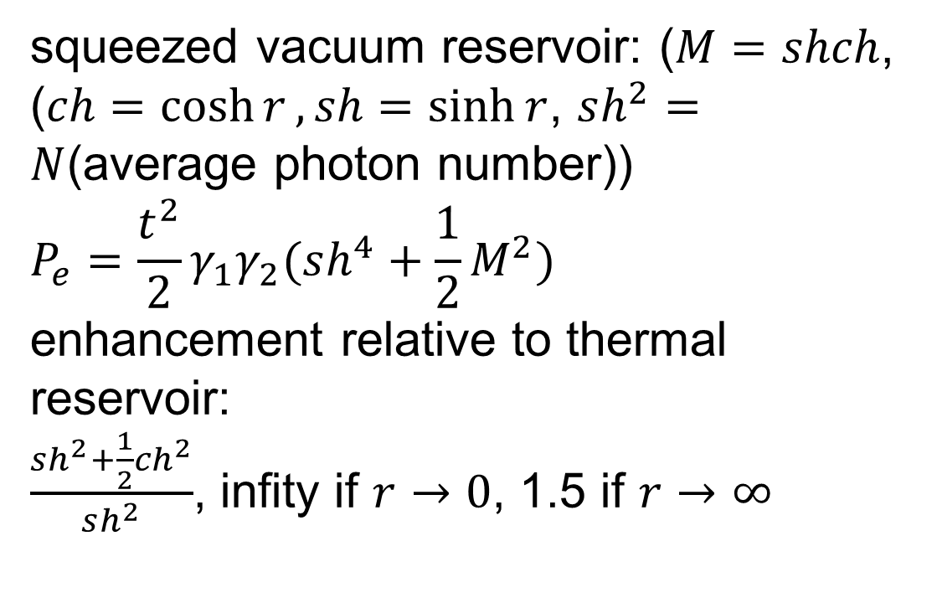
squeezed vacuum reservoir: ($M=shch$, ($ch=\cosh{r}, sh=\sinh{r}$, $sh^{2}=N$(average photon number))
$$P_{e}=\frac{t^{2}}{2}γ_{1}γ_{2}(sh^{4}+\frac{1}{2}M^{2})$$
enhancement relative to thermal reservoir:
$\frac{sh^{2}+\frac{1}{2}{ch}^{2}}{sh^{2}}$, infity if $r→0$, 1.5 if $r→∞$
$$|e⟩$$
$$ω_{0}$$
$$|m⟩$$
$$ω_{0}$$
$$|g⟩$$
compared to:
coherent state and squeezed coherent state(in lithography, entanglement enhances abs)

Slide 3
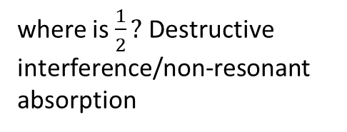



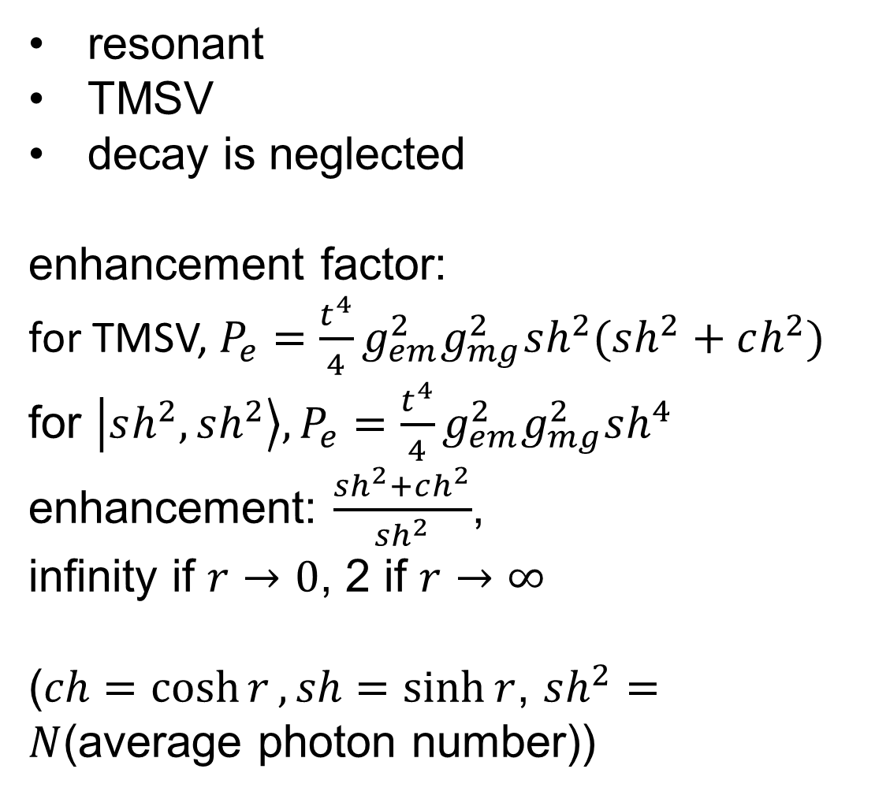
resonant
TMSV
decay is neglected
enhancement factor:
for TMSV, $P_{e}=\frac{t^{4}}{4}g_{em}^{2}g_{mg}^{2}sh^{2}(sh^{2}+ch^{2})$
for $\left|sh^{2},sh^{2}\right\rangle , P_{e}=\frac{t^{4}}{4}g_{em}^{2}g_{mg}^{2}sh^{4}$
enhancement: $\frac{sh^{2}+ch^{2}}{sh^{2}}$,
infinity if $r→0$, 2 if $r→∞$
($ch=\cosh{r}, sh=\sinh{r}$, $sh^{2}=N$(average photon number))
$$|e⟩$$
$$ω_{1}$$
$$|m⟩$$
$$ω_{2}$$
$$|g⟩$$
where is $\frac{1}{2}?$ Destructive interference/non-resonant absorption

Slide 4







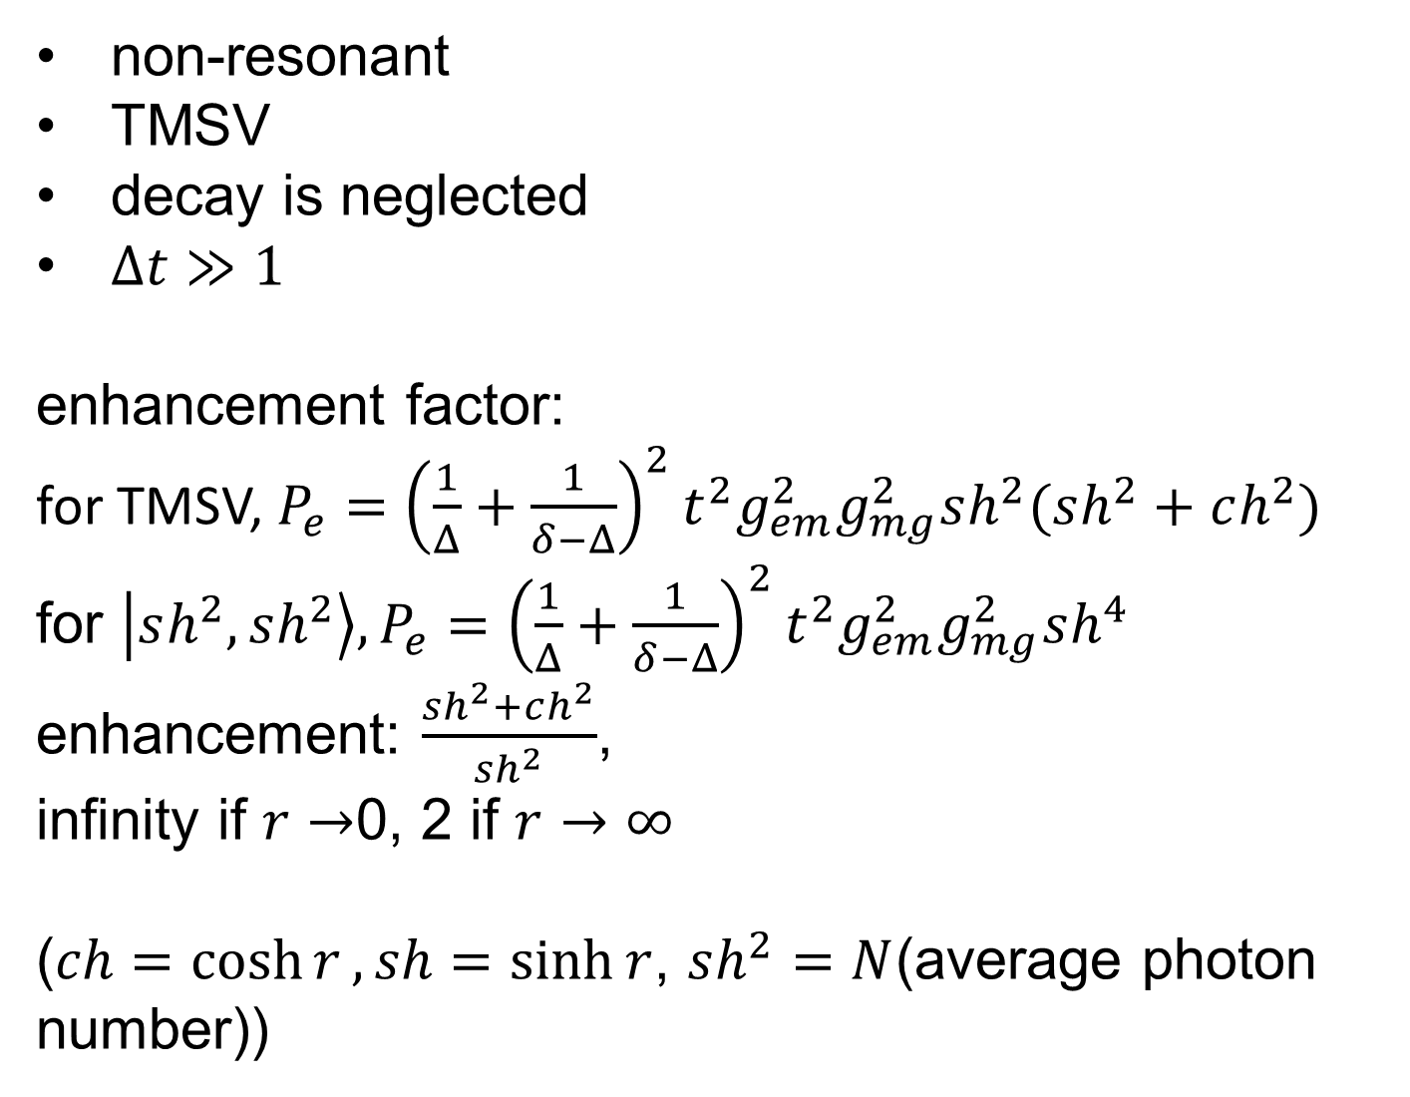

non-resonant
TMSV
decay is neglected
$Δt≫1$
enhancement factor:
for TMSV, $P_{e}={\left(\frac{1}{Δ}+\frac{1}{δ−Δ}\right)}^{2}t^{2}g_{em}^{2}g_{mg}^{2}sh^{2}(sh^{2}+ch^{2})$
for $\left|sh^{2},sh^{2}\right\rangle , P_{e}={\left(\frac{1}{Δ}+\frac{1}{δ−Δ}\right)}^{2}t^{2}g_{em}^{2}g_{mg}^{2}sh^{4}$
enhancement: $\frac{sh^{2}+ch^{2}}{sh^{2}}$,
infinity if $r→$0, 2 if $r→∞$
($ch=\cosh{r}, sh=\sinh{r}$, $sh^{2}=N$(average photon number))
$$|e⟩$$
$$ω_{1}−Δ$$
$$ω_{1}$$
$$|m⟩$$
$$ω_{2}+Δ$$
$$ω_{2}$$
$$|g⟩$$
$$δ=ω_{1}−ω_{2}$$

Slide 5
conclusion: photon number entanglement can enhance two-photon absorption

